Slide 1
Early Insights
Team B

Slide 2
Project Description
The city of Boston is interested in a report regarding the nature of animal complaints on the city’s 311 app. This includes the number of complaints, kinds of animals, distinct geographic areas where animal complaints are common, and trends in said complaints (such as season, or weather)

Slide 3
Methodology
Data Collection
Collected animal complaint data from Boston 311 service logs
Data Refinement
Fixed errors and removed duplicates entries for accuracy
Data Sorting
Sorted data by year and animal type involved in complaints
Data Visualization
Used graphs to show complaint trends over time and bar charts for the frequency of complaints by animal category
Data Analysis
Identified key trends and shifts in the data with visuals

Slide 4
Question 1 - How many reports were filed in the previous 2-3 years and 5-10 years, and are there any discernible trends in these reports, such as increases or decreases in total numbers?

Slide 5
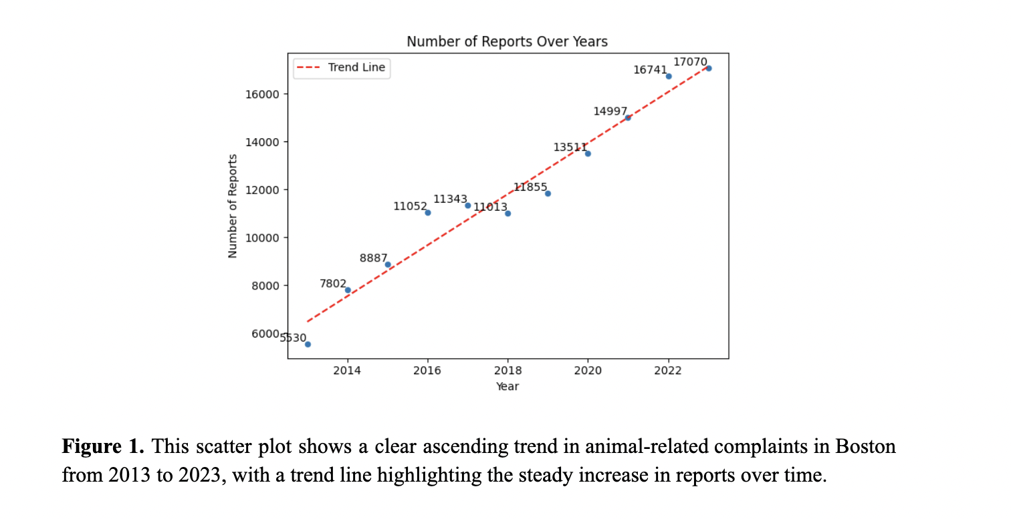
Question 1

Slide 6
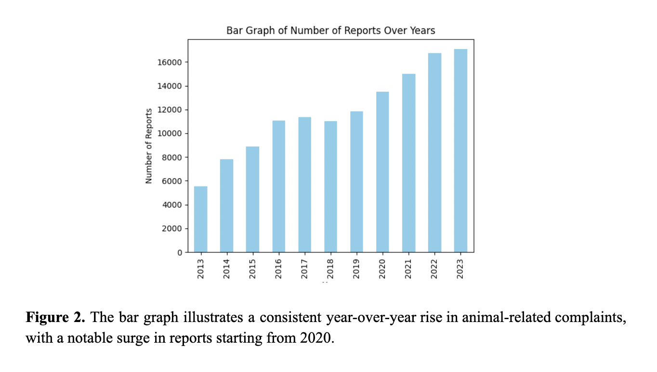
Question 1

Slide 7
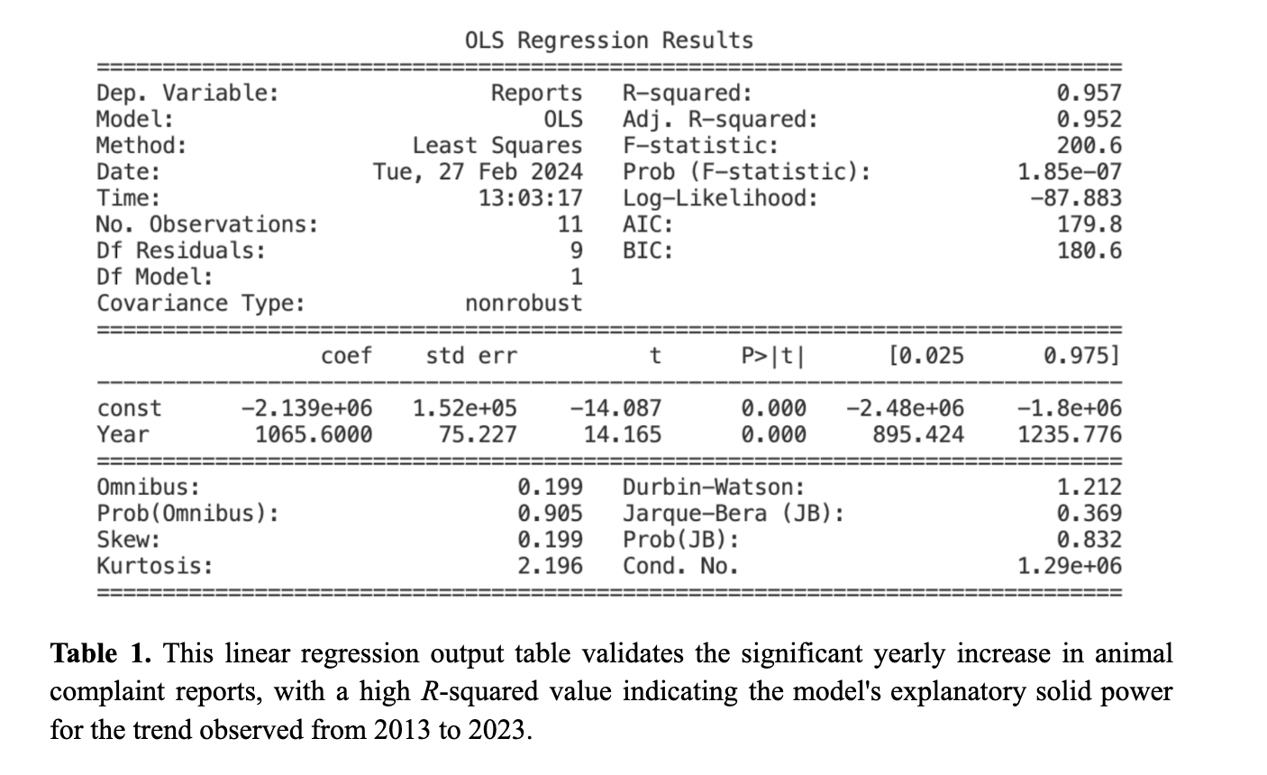
Question 1

Slide 8
Key Insights - Question 1
Increased public awareness and accessibility to reporting mechanisms
Improvements in technology and ease of reporting may encourage more individuals to report animal encounters
Urbanization and changes in land use patterns
Could result in greater human-wildlife interactions
Environmental changes
Habitat loss
Alterations in wildlife behavior due to climate variability

Slide 9
Question 2 - What types of animals are most commonly reported in complaints?

Slide 10
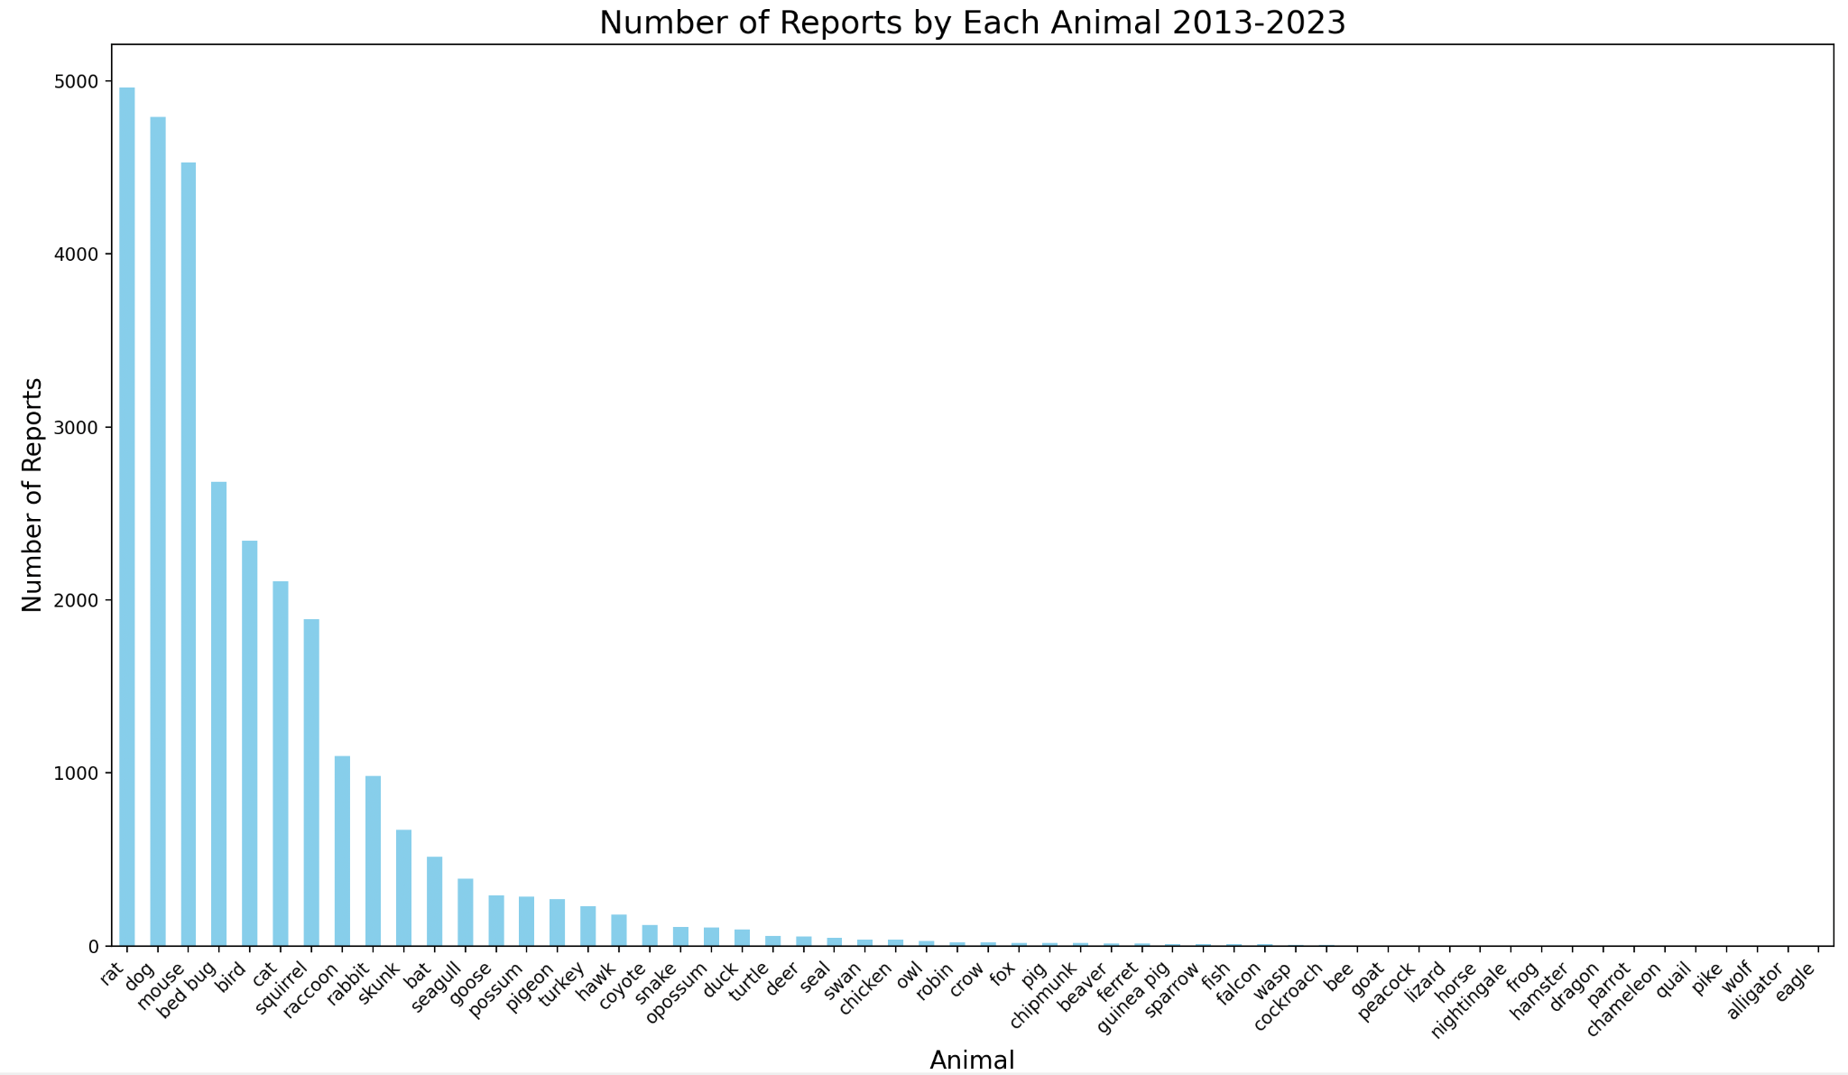
Question 2
Figure 3. This bar graph illustrates the frequency of animal-related complaints, highlighting rats, dogs, and mice as the most commonly reported issues over the selected time frame.

Slide 11
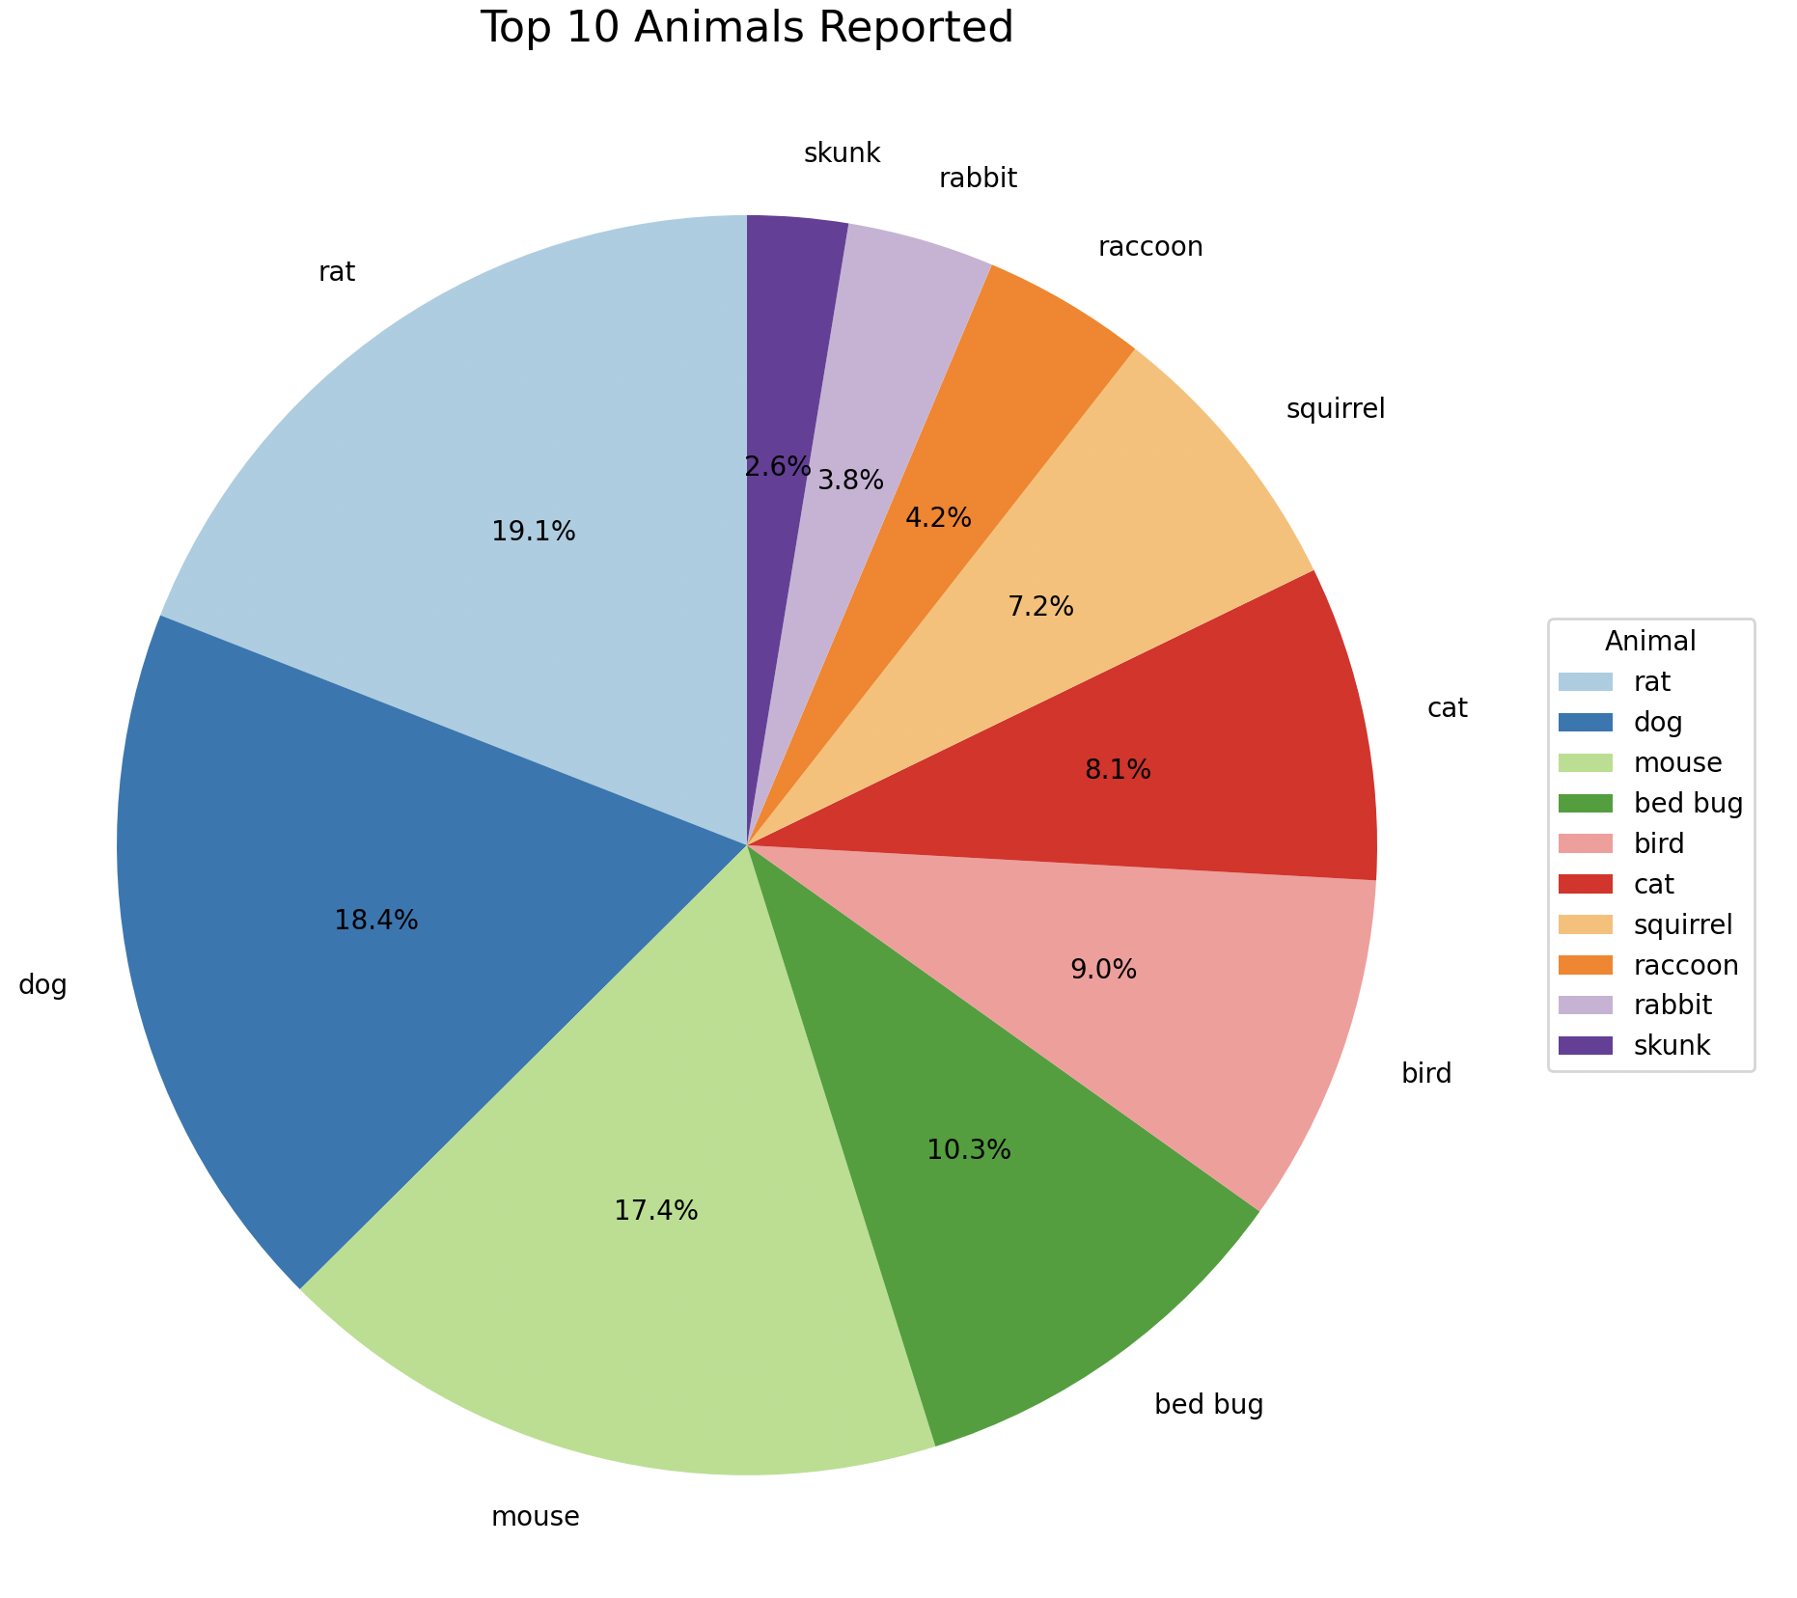
Question 2
Figure 4. The pie chart visually represents the proportion of each animal category in the total number of complaints, with rats, dogs, and mice making up the most significant segments.

Slide 12
Key Insights - Question 2
Signals a pressing need for more targeted rodent control and public health strategies
Potentially aid the city of Boston in several ways:
Resource Allocation
Public Health Initiatives
Urban Planning

Slide 13
Next Steps
Integrate GIS data for spatial analysis
identify hotspots of animal-related complaints and inform targeted interventions to address specific areas of concern.
Explore time trends
Analyze patterns to determine if there are specific times of day or months/seasons when reporting occurs more frequently
Conduct species-specific analysis
Investigate whether certain species are more concentrated in particular areas

Slide 14
Thank you!

